Slide 1
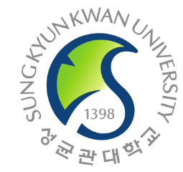
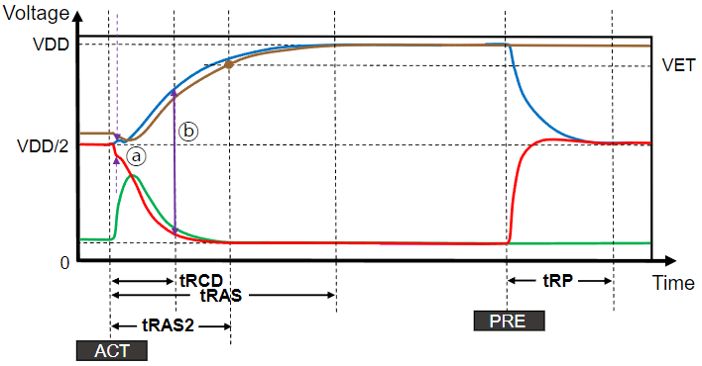
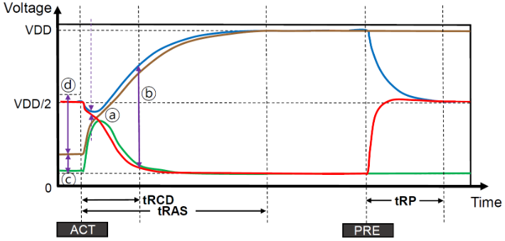
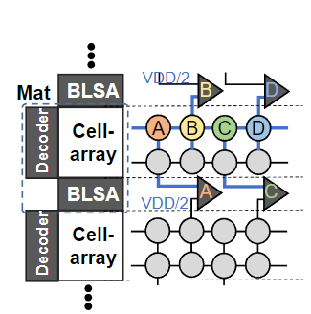
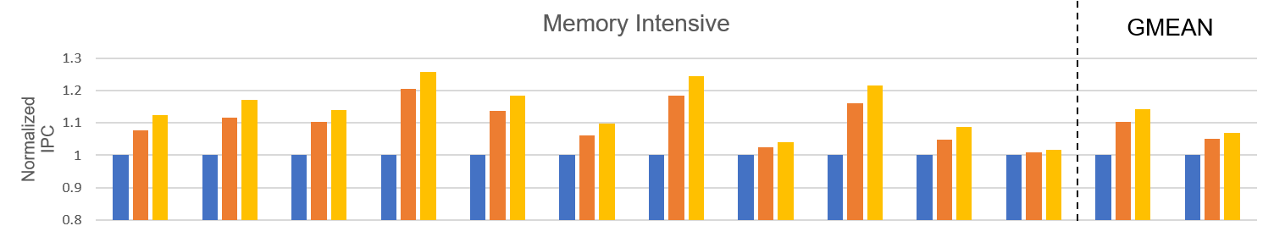
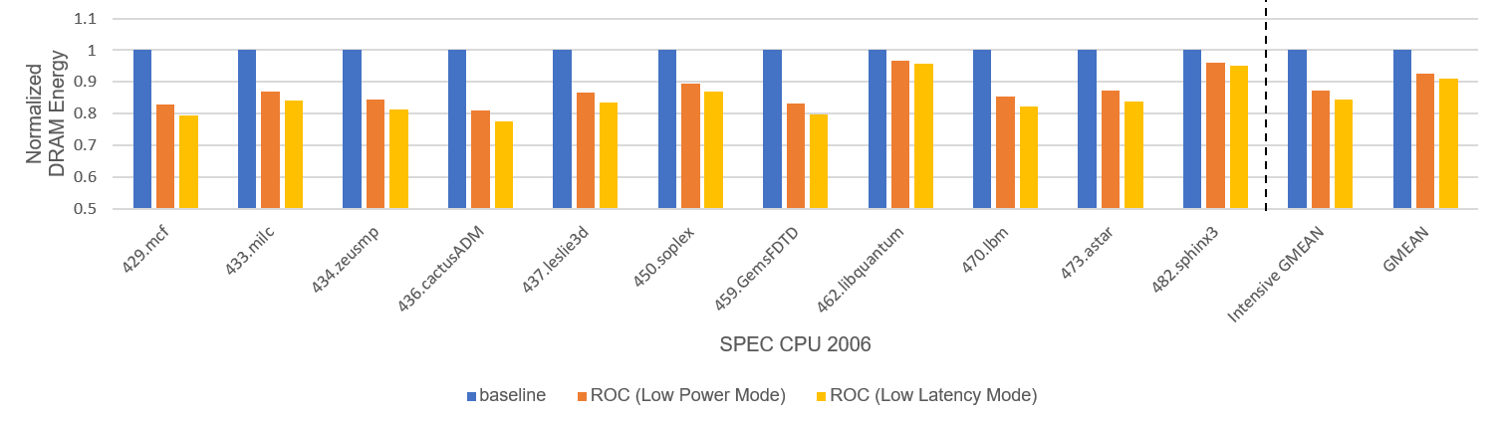
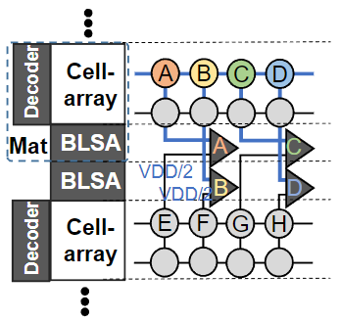
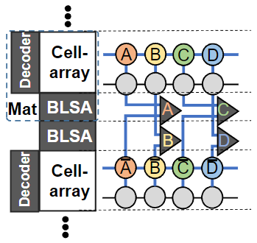

ROC-DRAM: Low Latency and Low Power DRAM
using Rows with Opposite Charging
Jaeyoon Lee, Daero Kim, and Jungrae Kim
Abstract
Low-
Latency
(LL)
DRAM access latency plays a critical role in modern computers. Prior works suggested latency optimizations, yet cost-sensitive DRAM vendors are reluctant to sacrifice their area efficiency. This paper proposes a novel DRAM architecture that can dynamically trade DRAM capacity for low latency and low power with minimal costs. Rows with Opposite Charging DRAM (ROC-DRAM) can exploit under-utilized capacity to improve latency and power consumption. It stores data in two rows with opposite charge levels and feeds them to a bitline sense-amplifier. The larger gap from complementary cells allows faster sensing and longer retention time. Moreover, ROC-DRAM allows dynamic switching between max-capacity/low-latency/low-power modes to maximize savings.
Accelerated sensing key DRAM timing parameters (tRCD, tRAS, tWR, and tRFC). Rapid sensing is achieved as the discharged cell maintains a level close to GND, quickly pulling down the /bitline.
Introduction
Low-
Power
(LP)
Problem
DRAM access latency is crucial in modern computers, but cost-sensitive DRAM vendors hesitate to optimize latency at the expense of area efficiency.
Goal
Allows for an increase in tREF. Referring to the /bitline written with GND creates resistance to cell charge loss. Allowing the charged cell to go far below VDD/2, as long as there is a sensible voltage difference between the original and complementary bitlines.
Improve access latency and refresh overheads in data centers with under-utilized memory capacity.
Key Idea
Leverages complementary cells to enable faster sensing operations and extended retention times with minimal modifications to the DRAM internal structure.
Results
Conventional Structure
In the open-bitline structure, a BLSA receives bitlines (bitline and /bitline) from two vertically adjacent mats. Only one mat can be activated at a time, while the other mat is inactivated. The bitlines of the inactivated mat (/bitline) are precharged to VDD/2 and serve as the reference voltage for the shared BLSA to sense the activated bitline (bitline).
Figure compares IPC / Energy of the baseline open-bitline architecture and other modes of ROC-DRAM with ET. Overall, the LL mode can speed up single-core execution by 6.9% using 23 SPEC CPU 2006 benchmarks. Also, LL mode reduces DRAM energy consumption by 9.0% on average.
Proposed Method
ROC-DRAM
Conclusion
This paper proposes a novel DRAM architecture, called Rows with Opposite Charging DRAM (ROC-DRAM), to provide efficient and flexible trade-offs among capacity, performance, and energy consumption to exploit under-utilized memory capacity in data centers. ROC-DRAM stores a bit of information in two cells in paired rows with opposite charge levels to trade capacity for performance and low power. And ROC-DRAM supports dynamic mode switching between max-capacity, low-latency, and low-power modes based on memory capacity utilization and application requirements. The proposed architecture demonstrates significant improvements in performance, energy efficiency, and refresh overheads, making it a promising solution for data centers with under-utilized memory capacity.
Supports low-latency and low-power modes (right figure), in addition to the default max-capacity mode (left figure).
DESIGN AUTOMATION CONFERENCE’23

